Slide 1
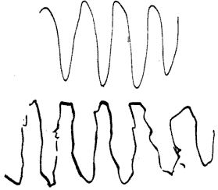
Pourquoi le trouble de fluidité motrice?
Absence de modèle de prédiction…

Slide 2
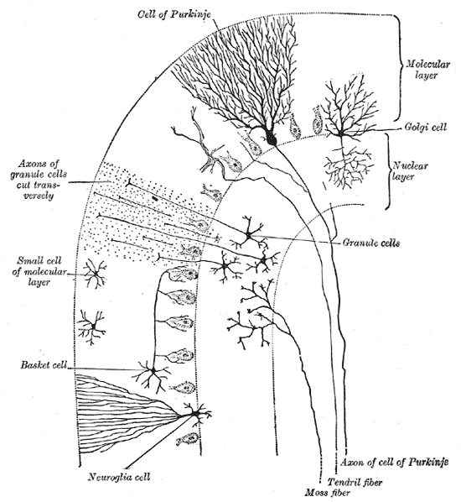

Slide 3
Micro anatomy
Two types of neuron play dominant roles in the cerebellar circuit:
Purkinje cells
granule cells.
Three types of axons also play dominant roles:
mossy fibers
climbing fibers (which enter the cerebellum from outside),
parallel fibers (which are the axons of granule cells).

Slide 4
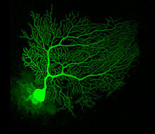
Purkinje cells
GABA neurotransmetteur
= inhibition
Purkinje cells are among the most distinctive neurons in the brain, and one of the earliest types to be recognized—they were first described by the Czech anatomist Jan Evangelista Purkyně in 1837.

Slide 5
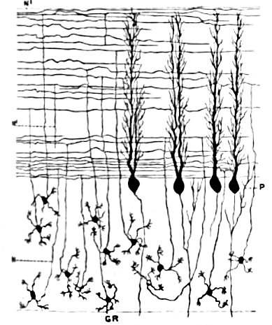
A granule cell emits only four to five dendrites = combinatorial coding
Granule cells, parallel fibers, and flattened dendritic trees of Purkinje cells

Slide 6
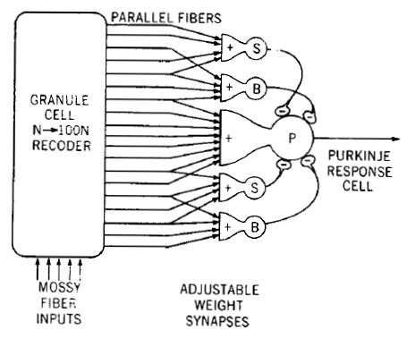

Slide 7
Comment découvrir le réseau cortical du système moteur?
Travail sur articles

Slide 8
Feedback error learning model

